Slide 1
Acoustic scattering benchmarking
08142026
Radius of sphere for all models: 5 cm
Radius of water domain for COMSOL models: 10 cm
Thickness of PML layer for COMSOL models: 1 cm

Slide 2
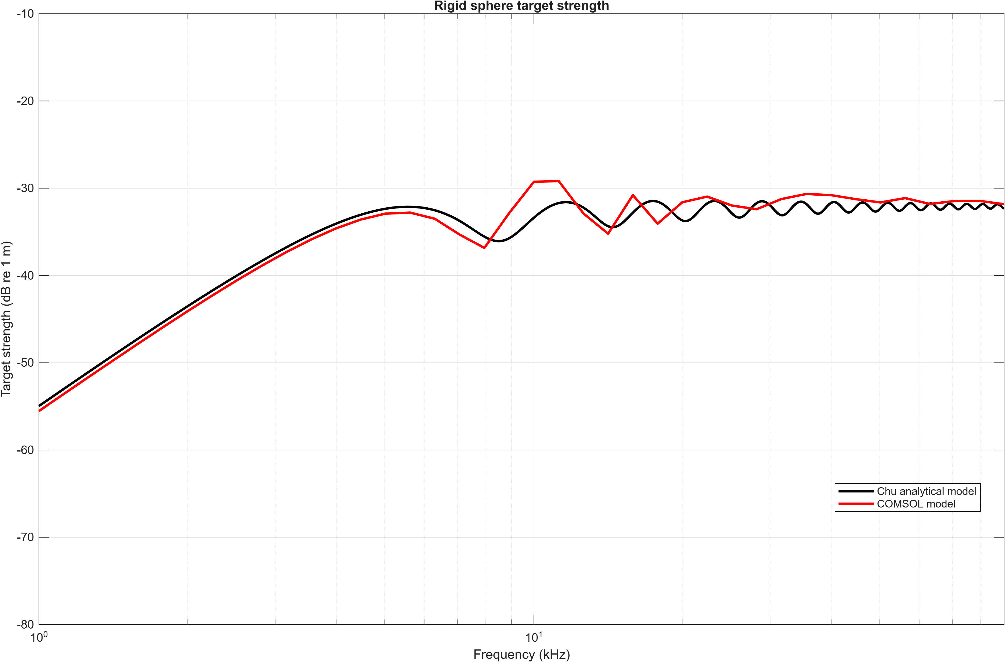

Slide 3
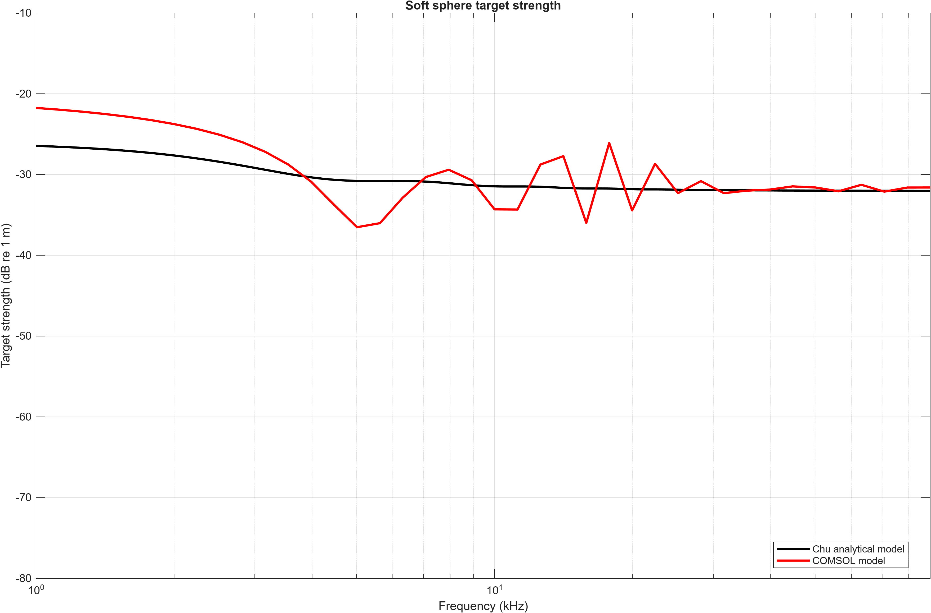

Slide 4
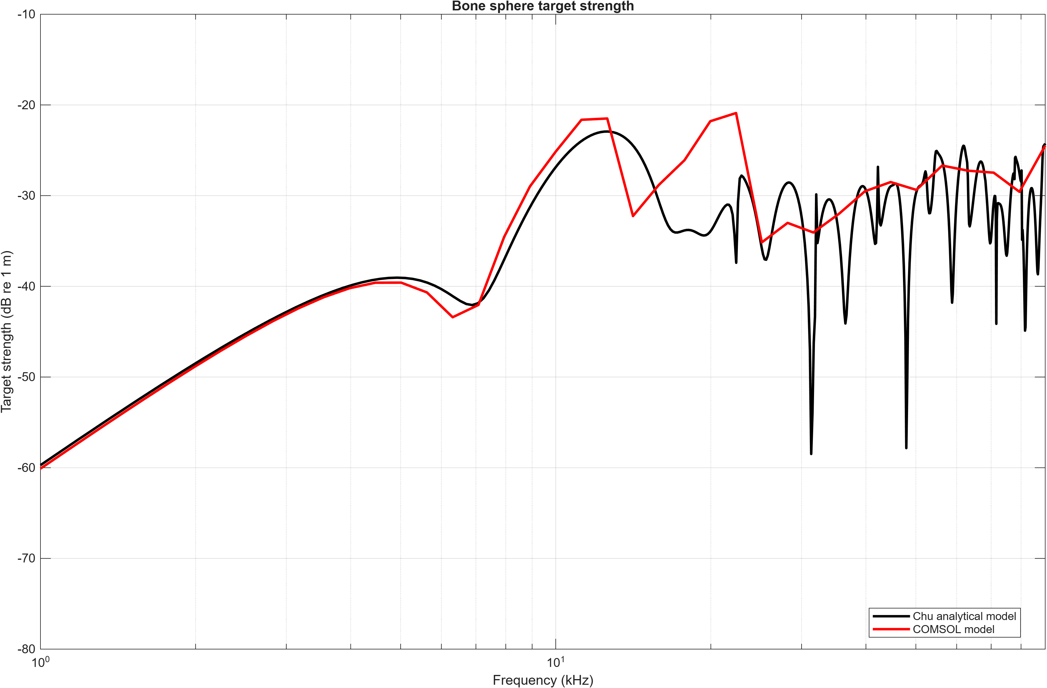

Slide 5
